Slide 1

25 11 24 Arran Schools
Tim Conner
Whiting Bay

Slide 2
Structure of presentation (this will be available to all staff)
About me
Why Outdoor Education or Outdoor Teaching?
Outline for today
Some resources

Slide 3
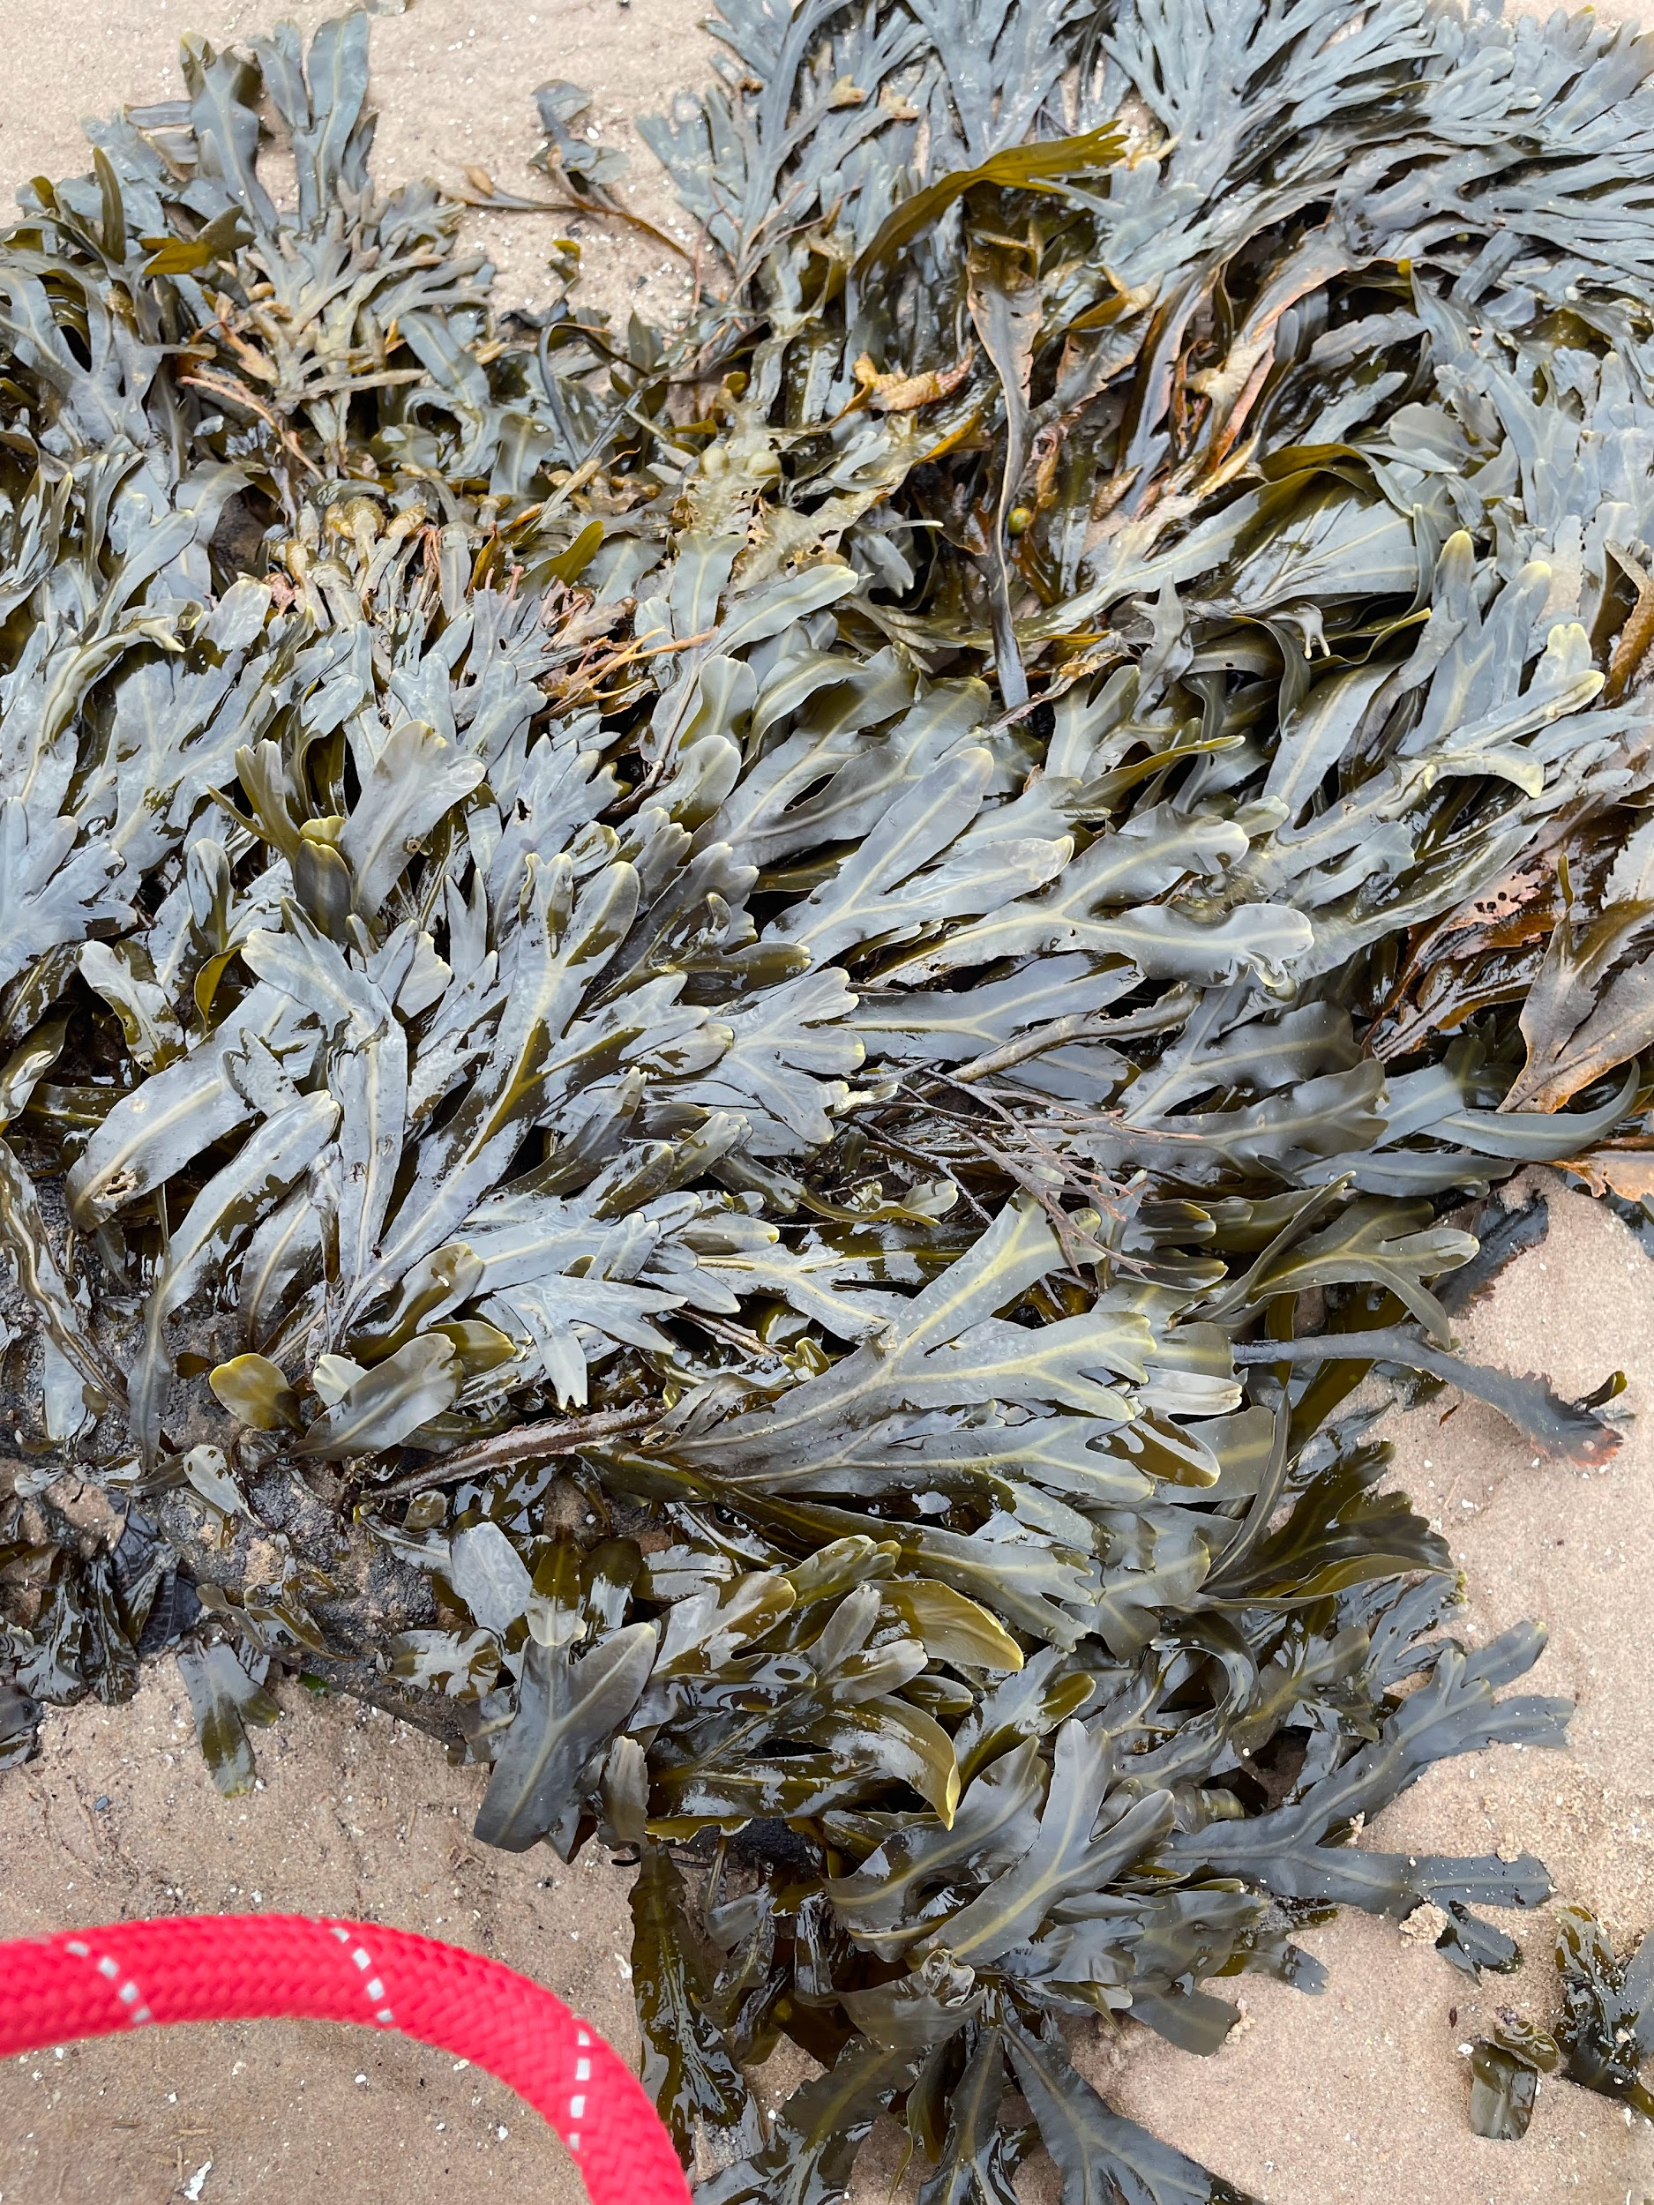
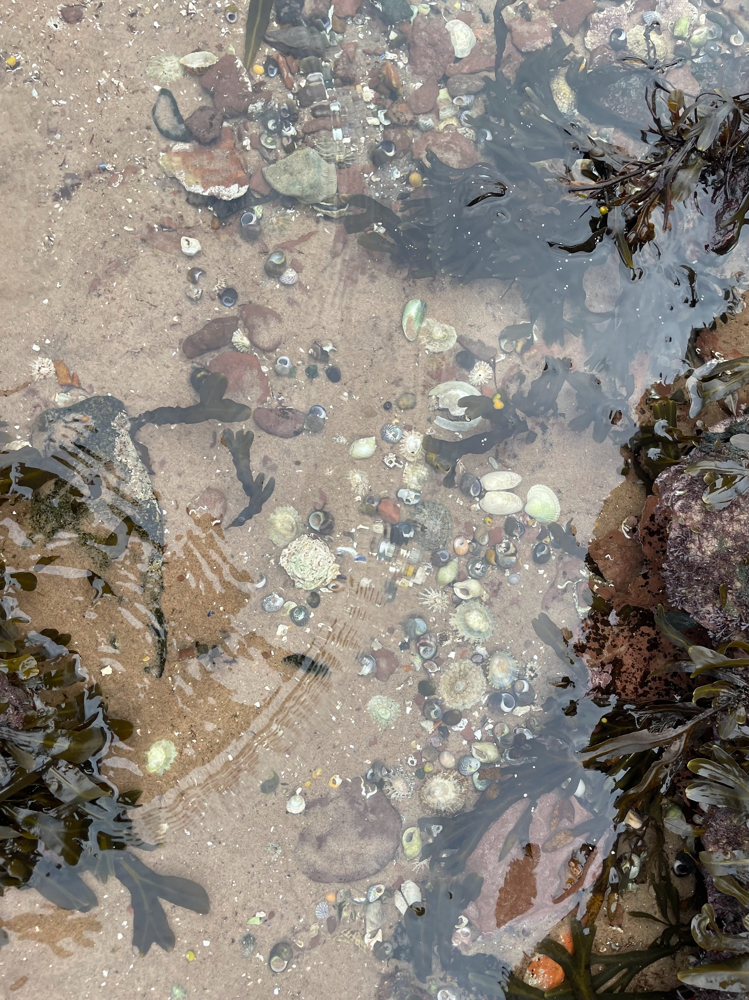
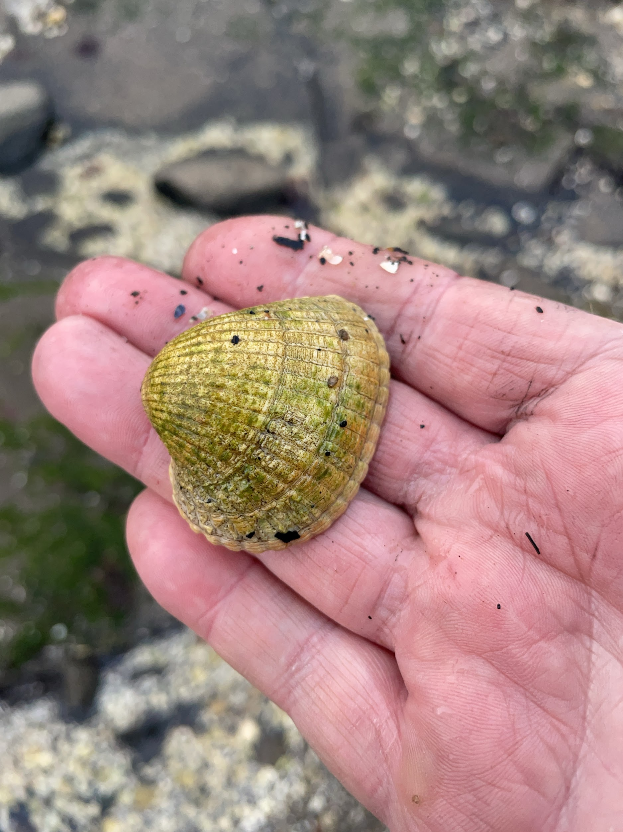
About me

Slide 4
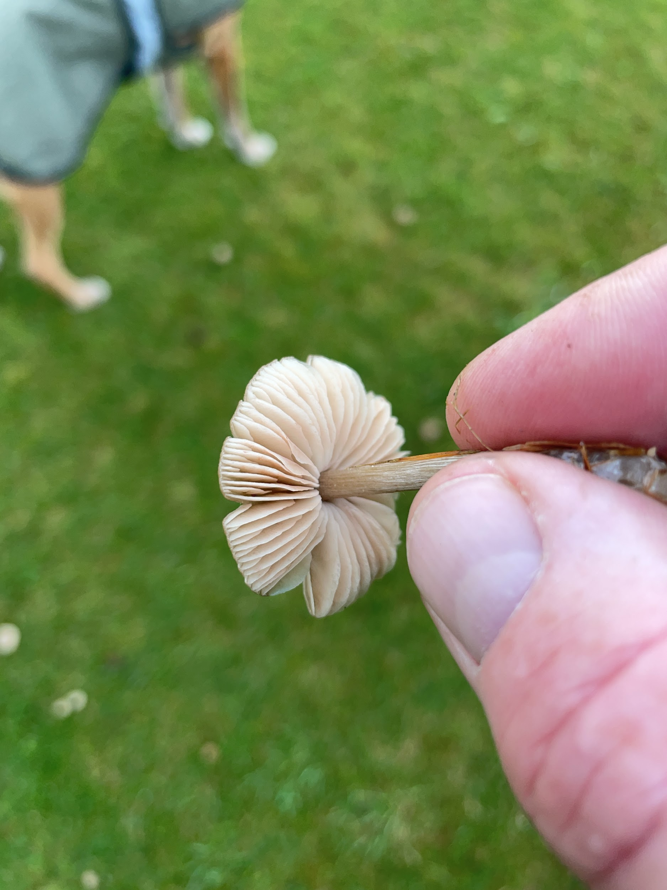
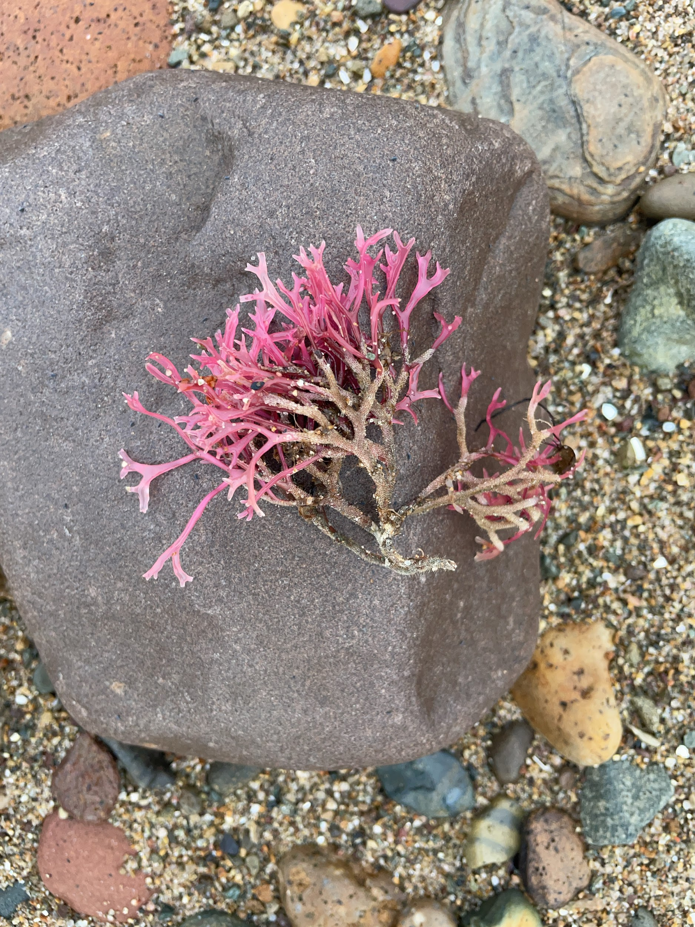
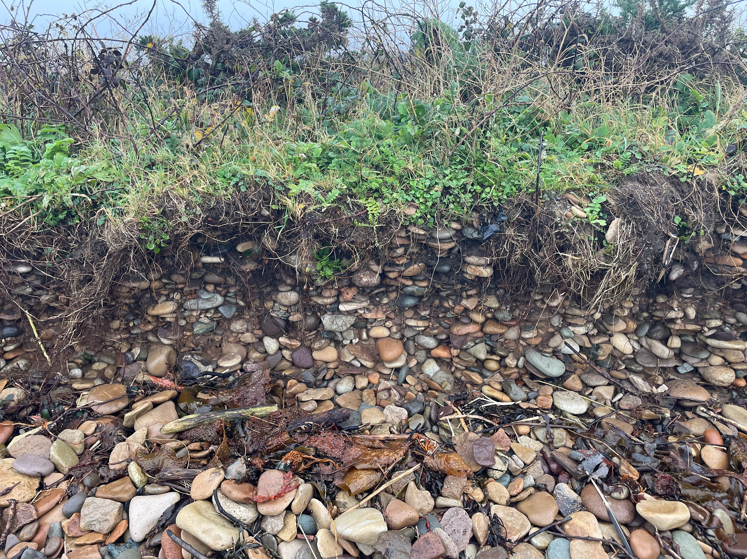
About me

Slide 5
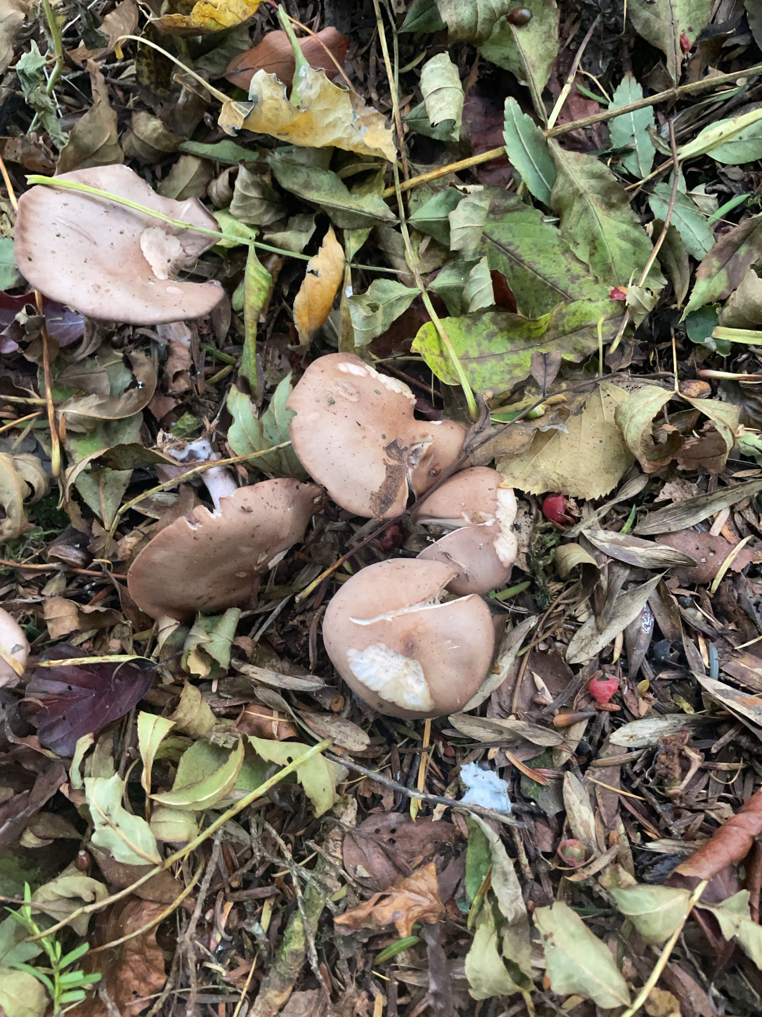
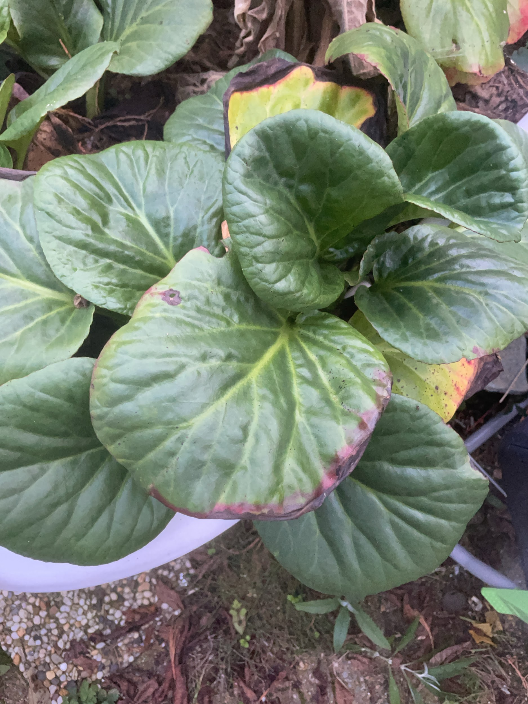
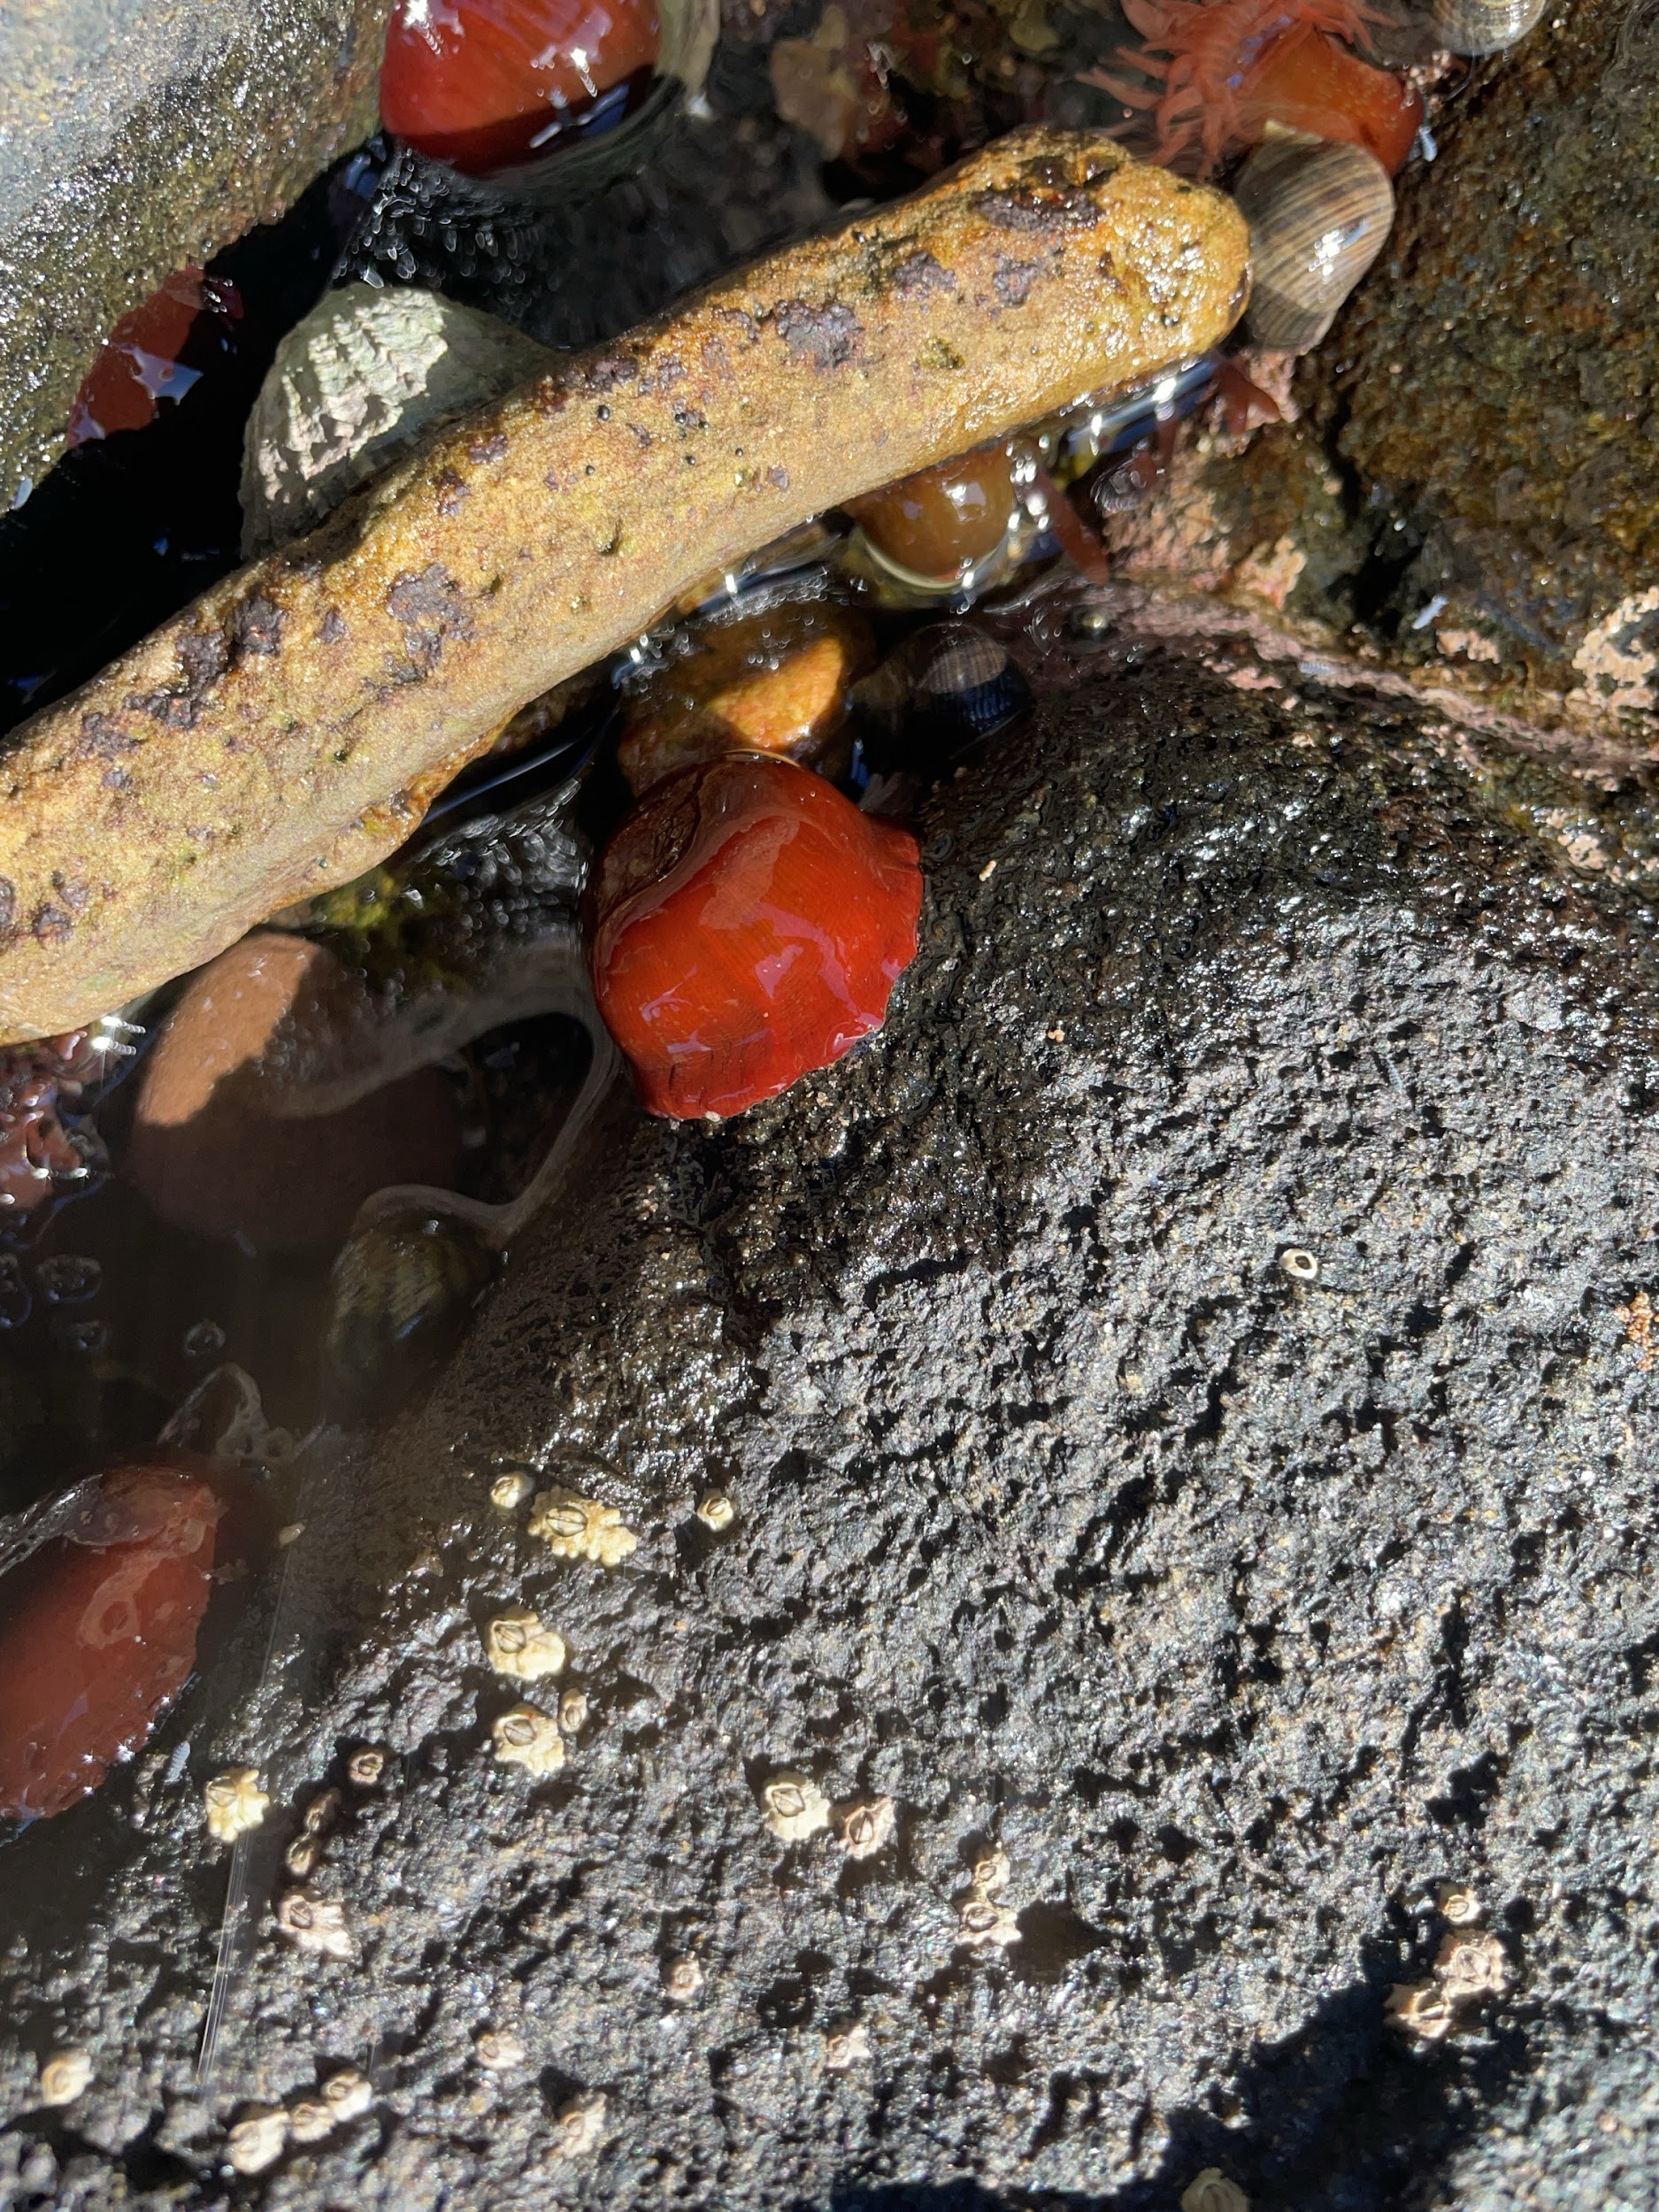

Slide 6
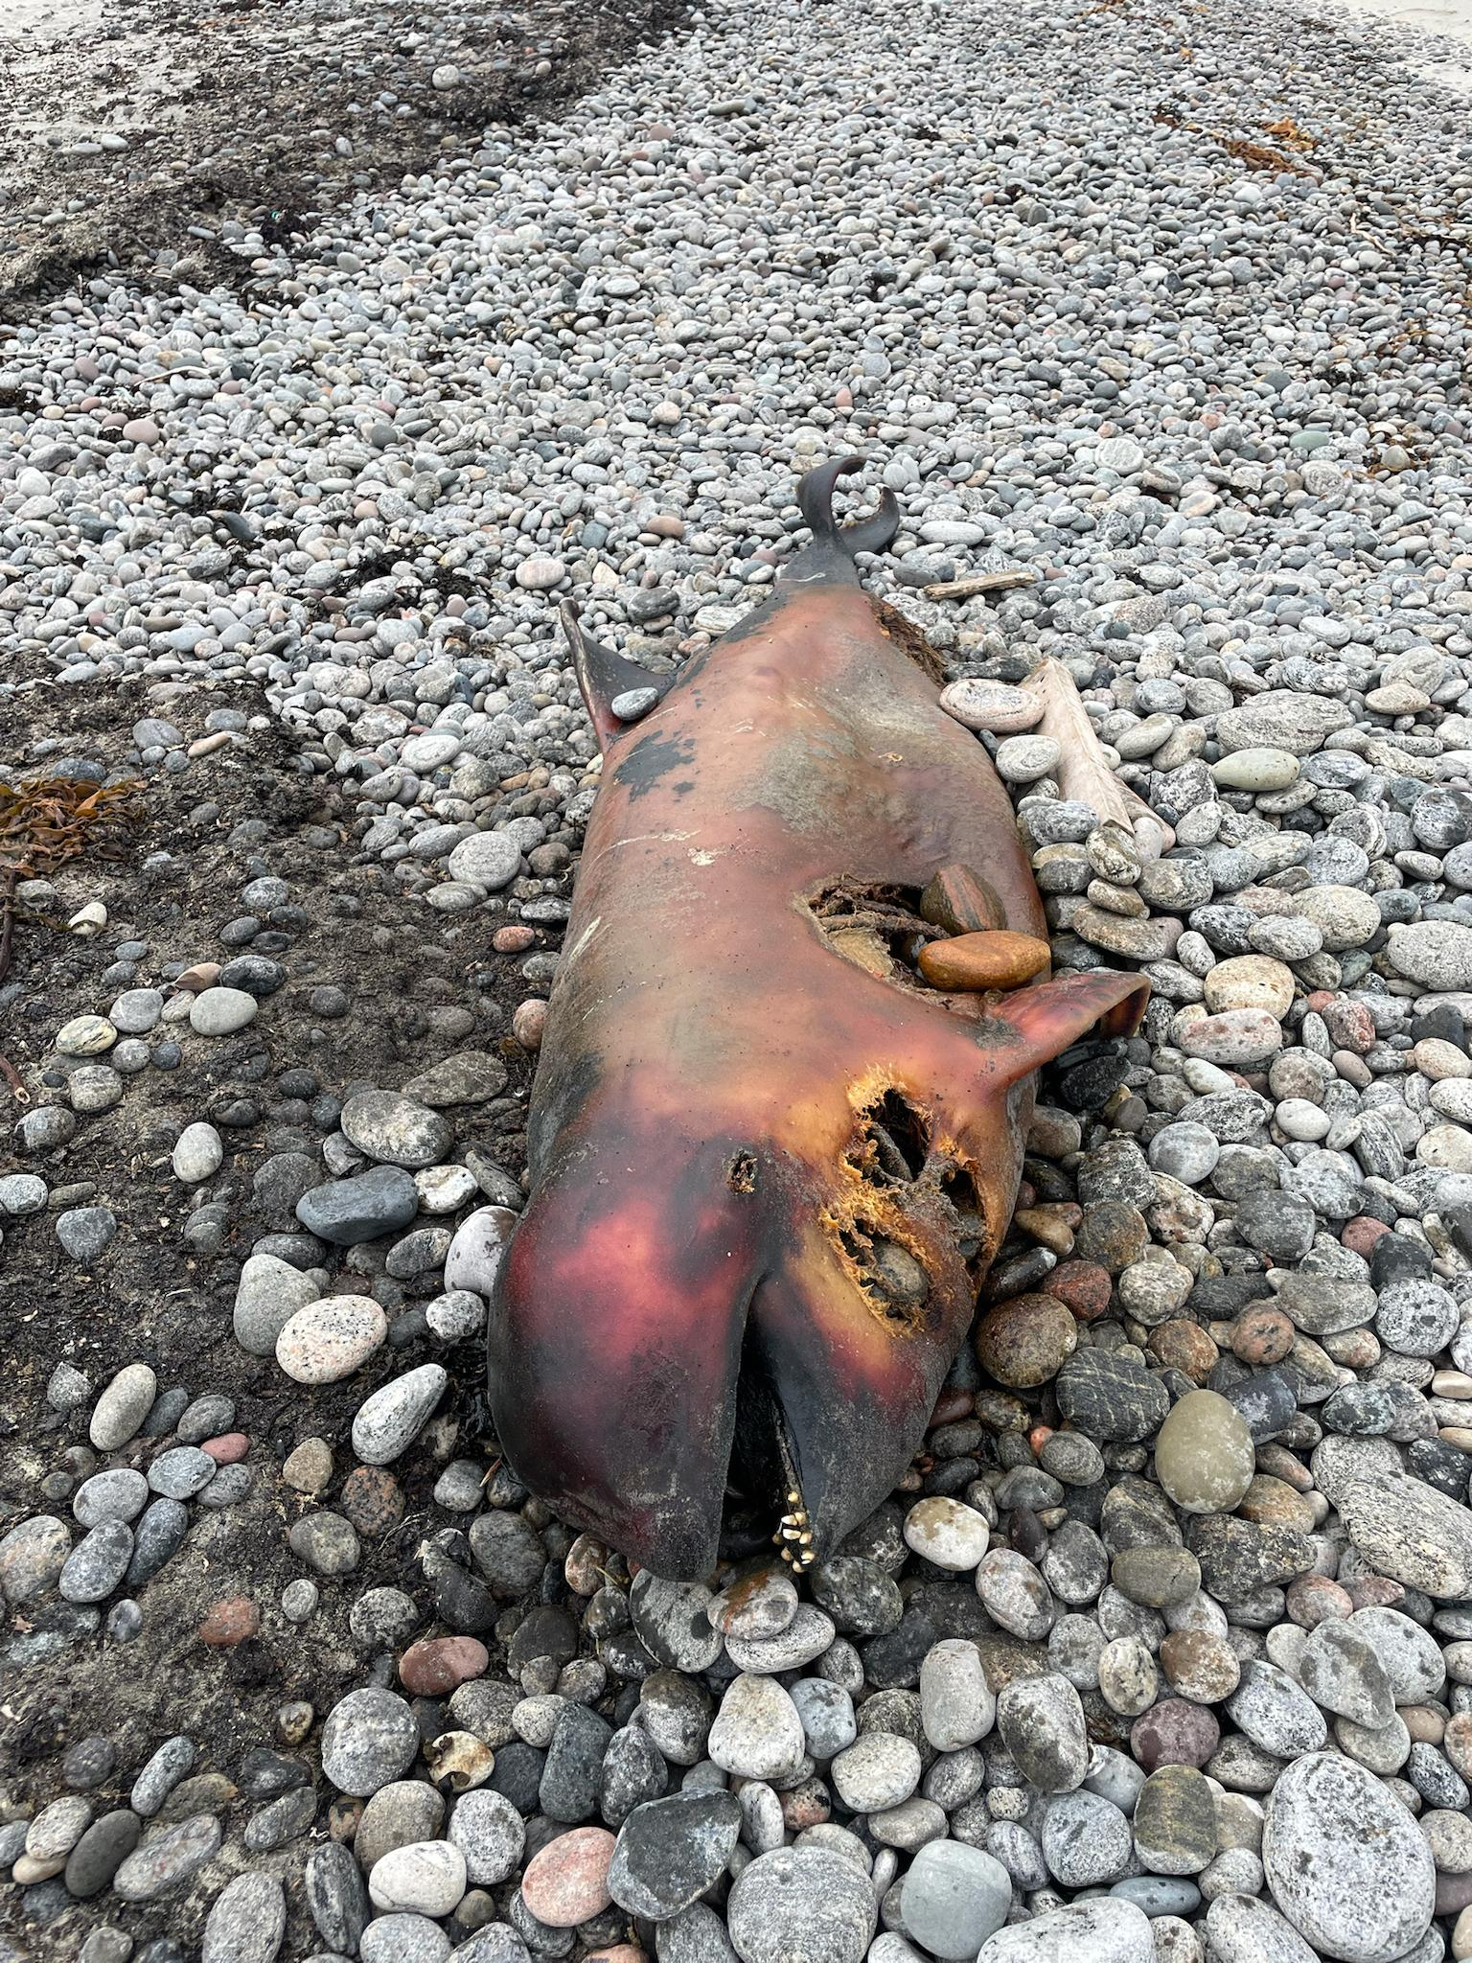
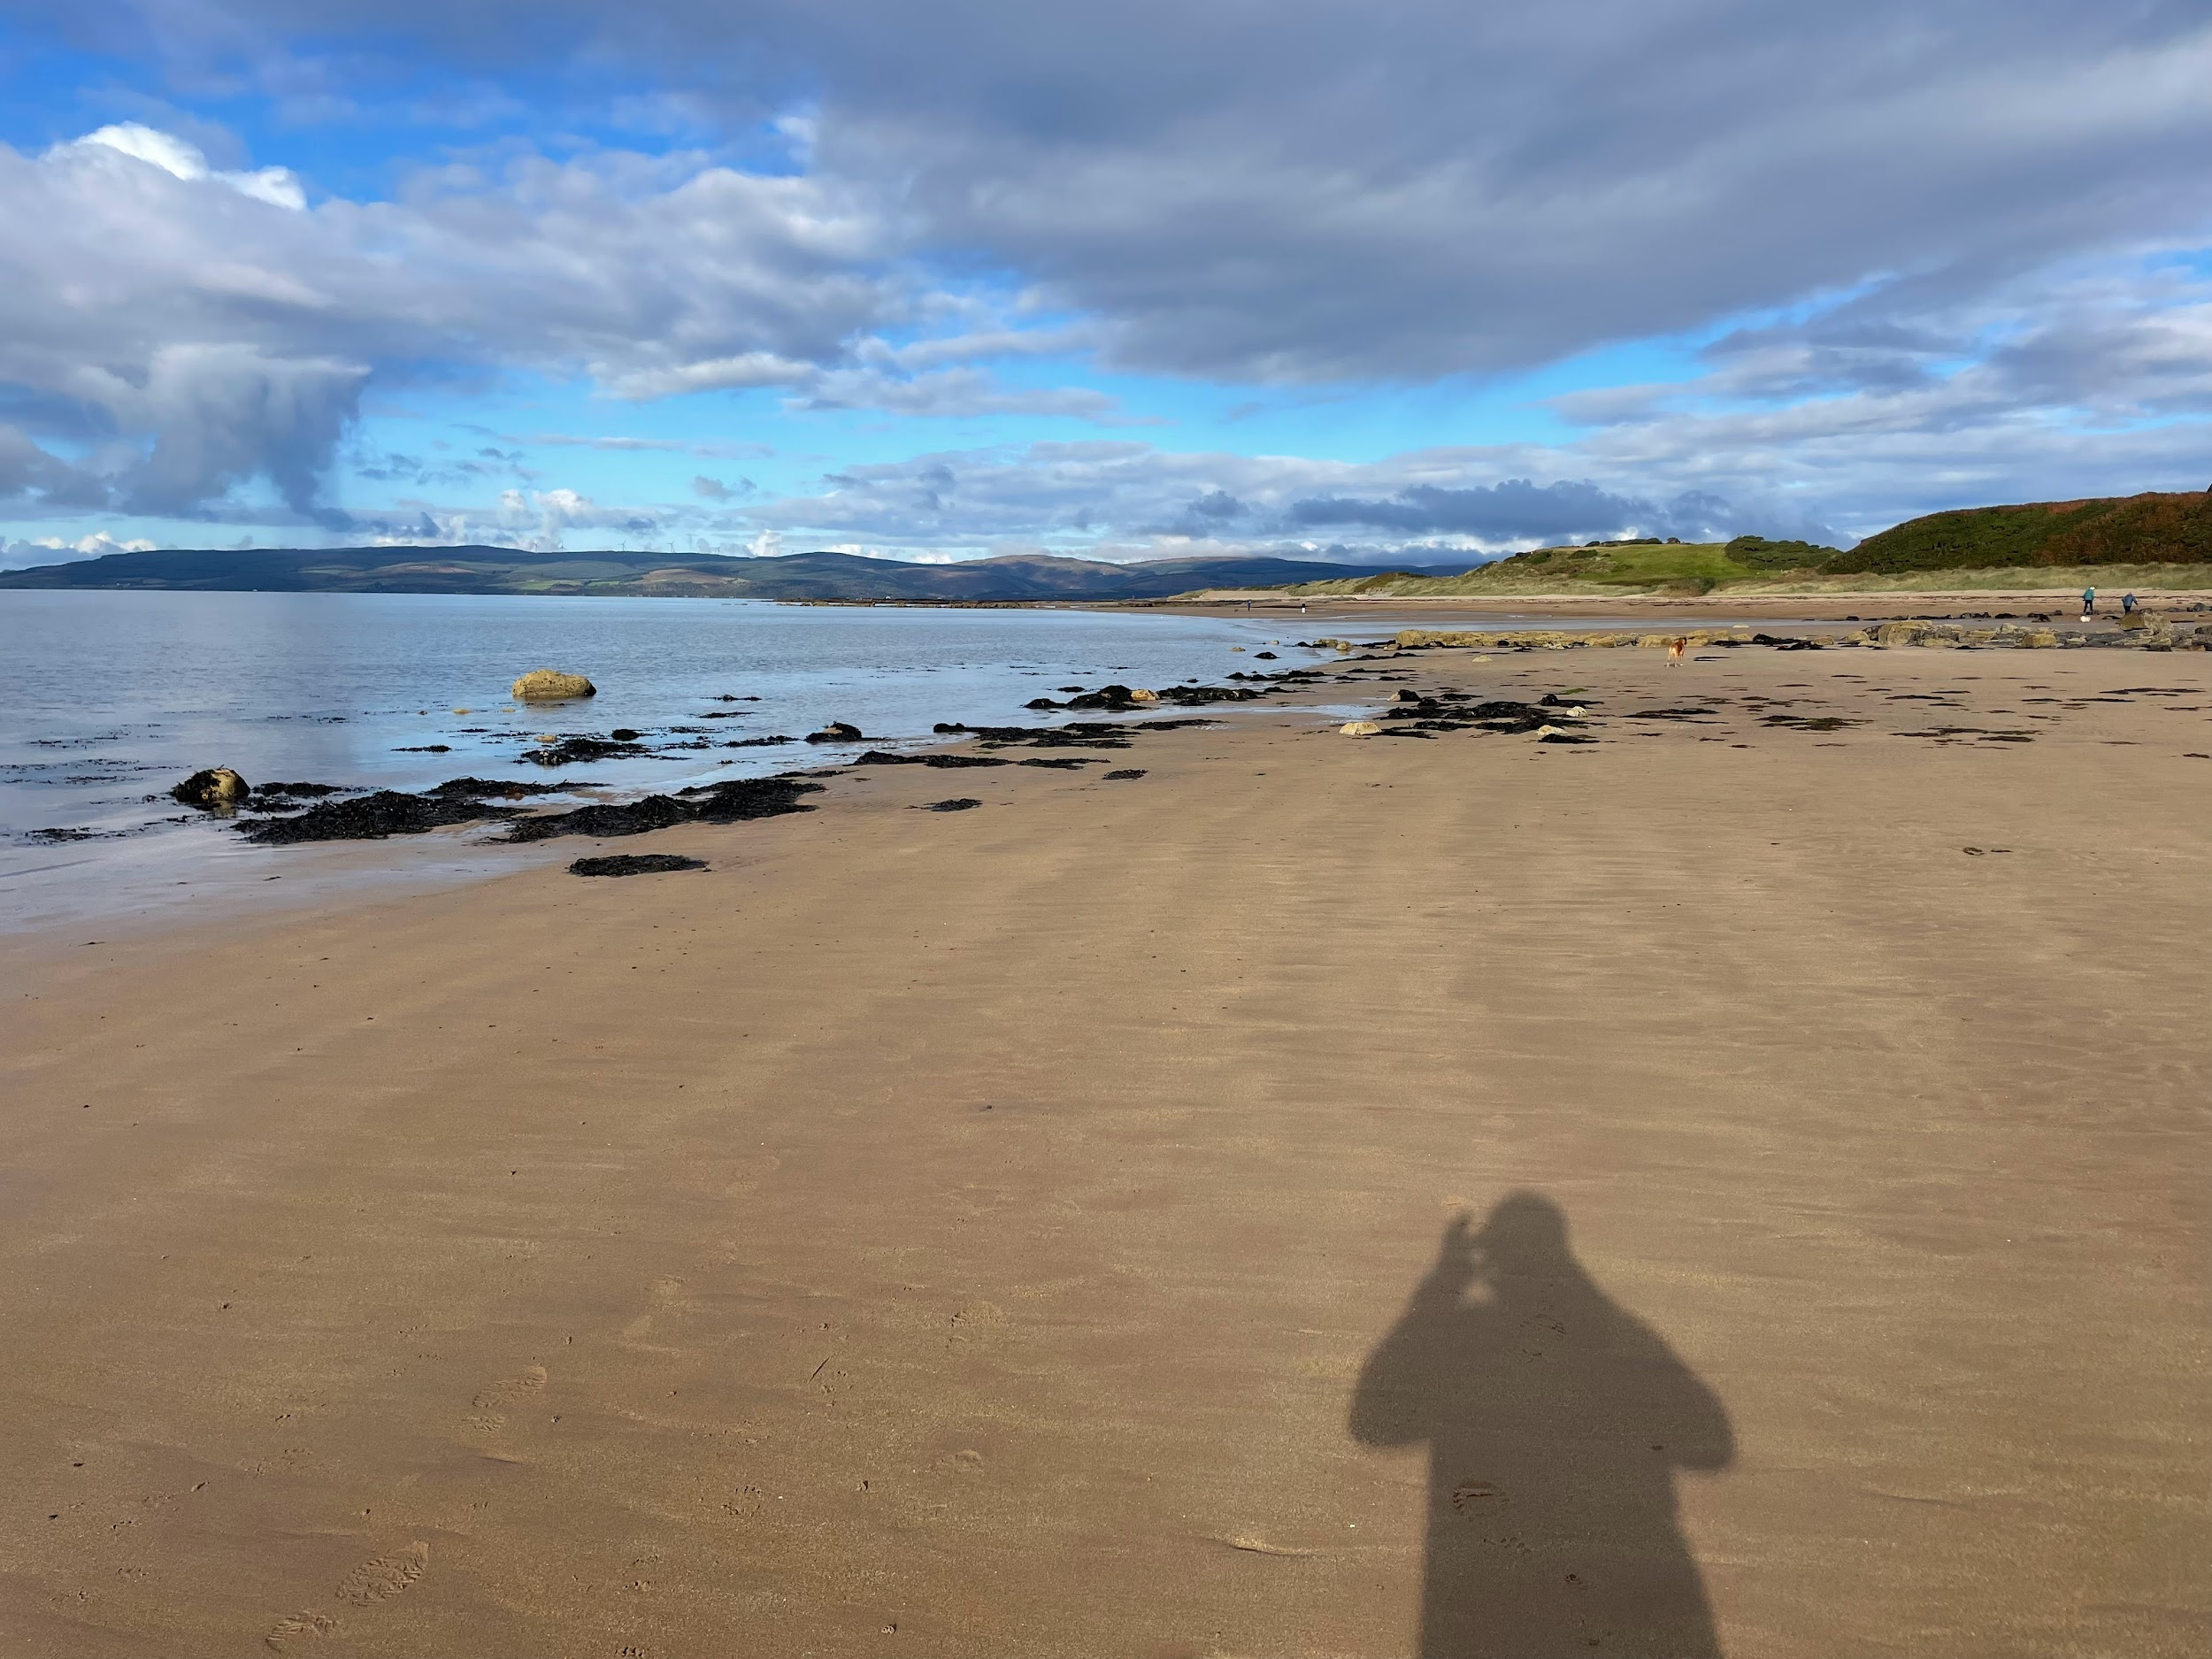
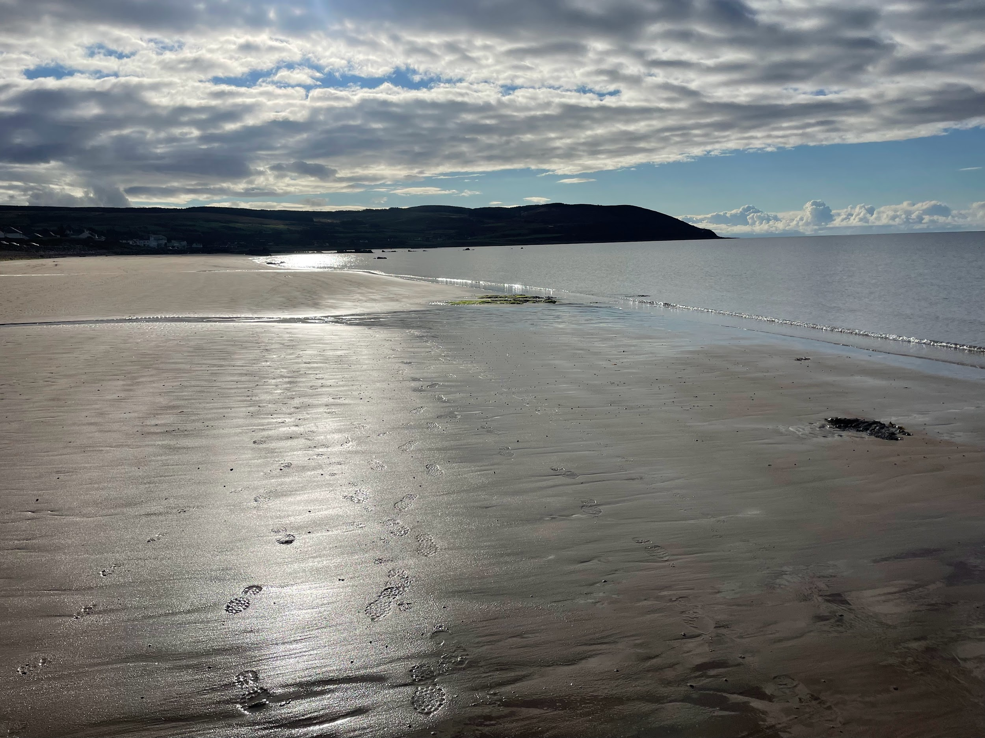
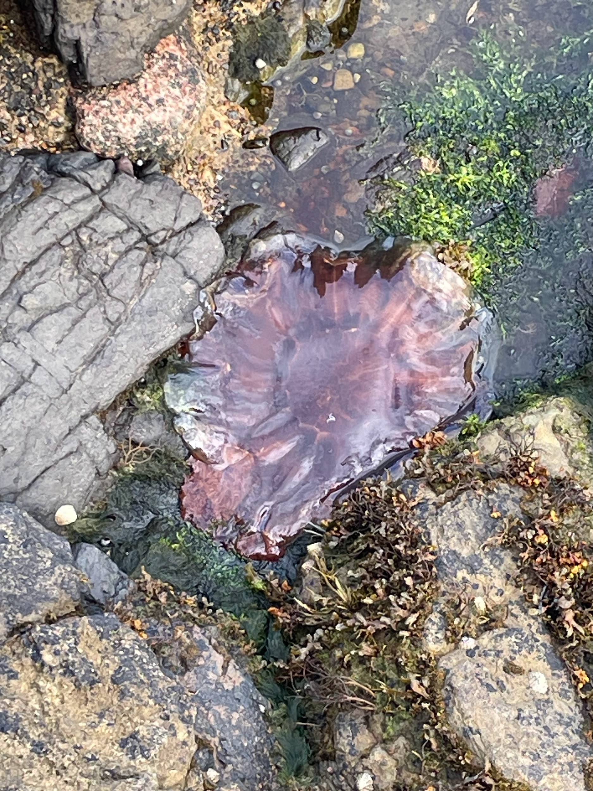

Slide 7
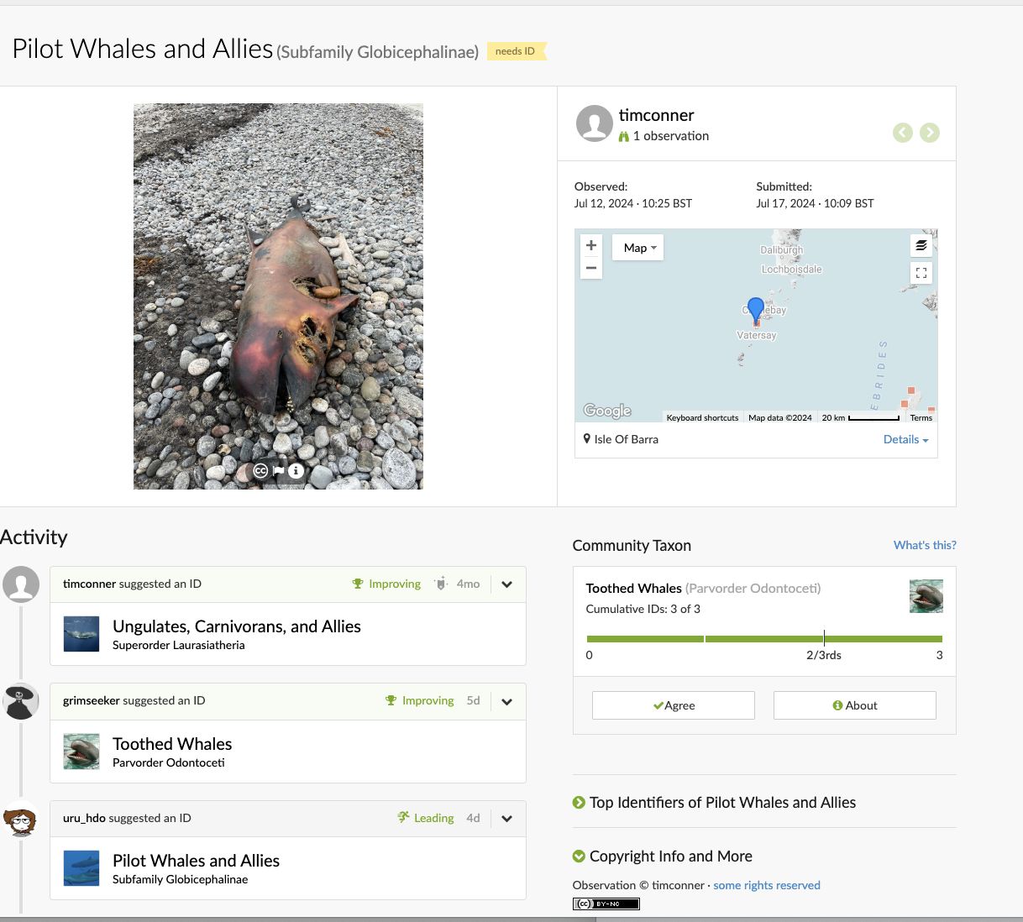

Slide 8

Why Outdoor Education or Outdoor Teaching?

Slide 9
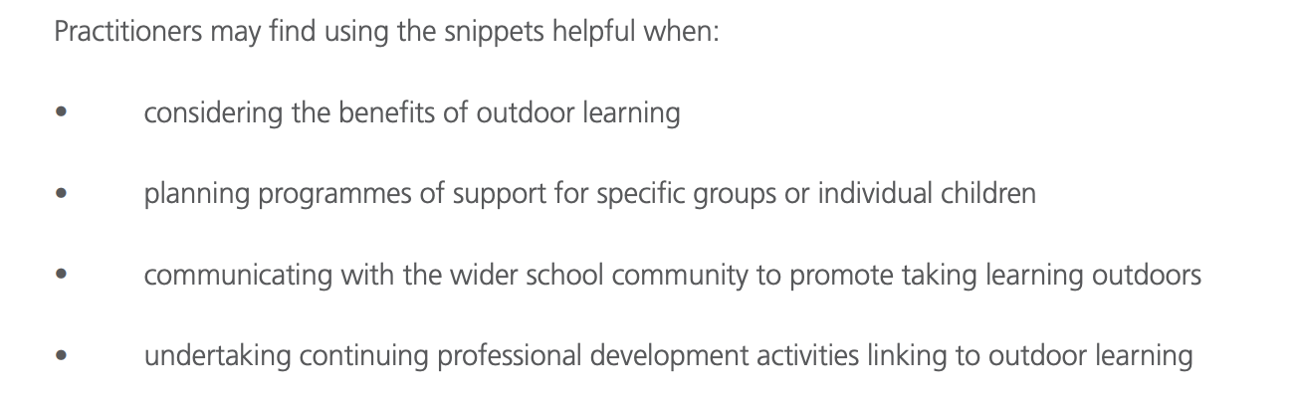

Slide 10
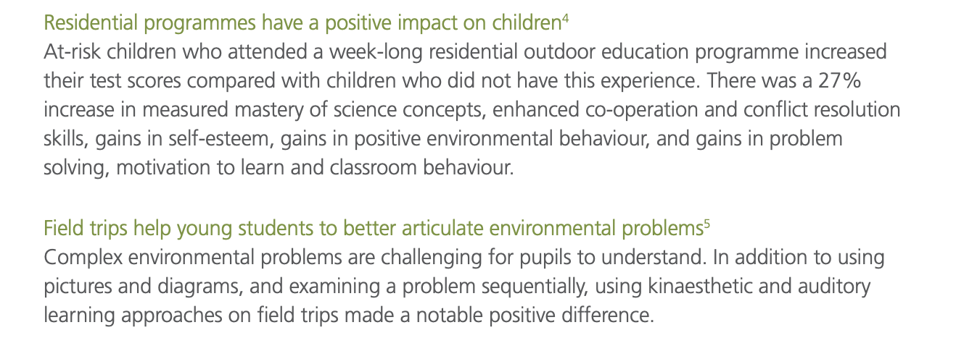

Slide 11
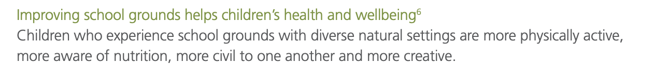
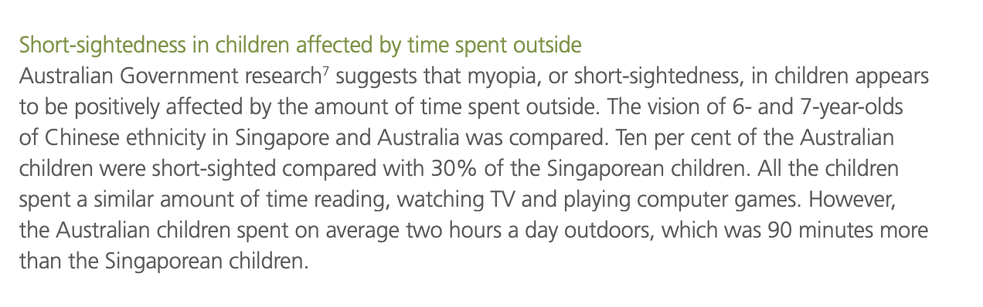

Slide 12
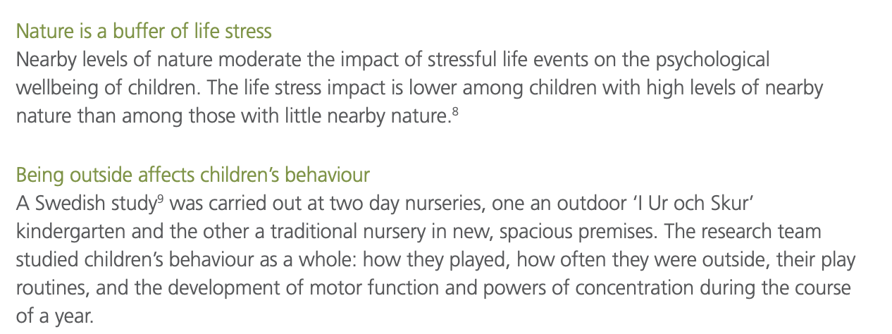

Slide 13
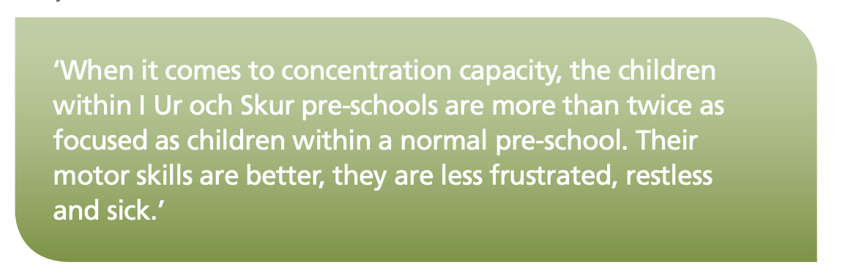

Slide 14
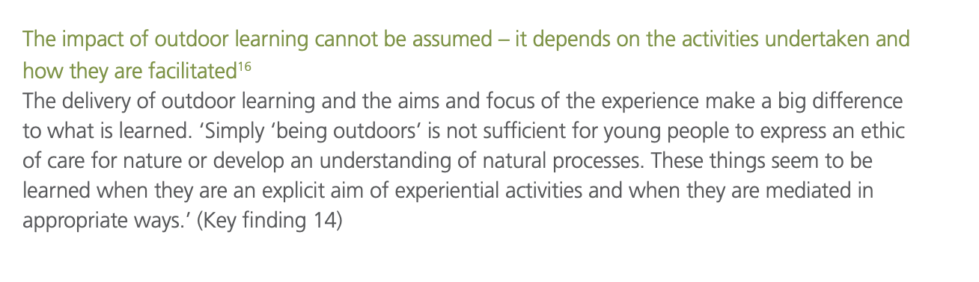

Slide 15


Slide 16
Why Outdoor Education or Outdoor Teaching?
Education Scotland
https://education.gov.scot/media/0fklf35p/hwb24-ol-support.pdf

Slide 17
Outline for today
Start to Coffee Time (10.30)
Intro./Sticky Toes/Resources/Beech Bingo/Scavenger Hunt
10.50 -12.15 Risk Benefit
12.15 - 1pm Lunch
1-2pm Your games time (small groups) 20 min plan 20 play 20 swop
2-3pm Lesson ideas and planning (5 sessions) Collaborative lesson planning

Slide 18
Apps and sites
Tides
Metoffice
Marine Traffic
Seek
iNaturalist
British Trees
Google Earth

